Slide 1
Country Comparison Analysis
Analyzing Economic and Healthcare Indicators Across Countries

Slide 2
Introduction and Objectives
Objective
Purpose
Analyze healthcare expenditure, GDP, and economic indicators across countries.
Compare countries over time to observe economic and health-related trends.

Slide 3

Data Preparation
Data sources were loaded and cleaned.
Handling null values and preparing data for analysis.

Slide 4
Challenges deep-dive
Challenge 1
Challenge 2
Challenge 3
Key Metrics Calculated
Mean healthcare expenditure was calculated before and after 2020 for each country.
Healthcare Expenditure
Comparative analysis on healthcare expenditure trends before and after 2020.
GDP and Other Metrics
GDP per capita, population growth rate, and other indicators provide a fuller economic picture.

Slide 5

Key Metrics Calculated
Mean healthcare expenditure was calculated before and after 2020 for each country.

Slide 6

Key Metrics Calculated
GDP, life expectancy, and other economic indicators were analyzed.

Slide 7

Healthcare Expenditure
Insights into countries' economic responses over the years.

Slide 8
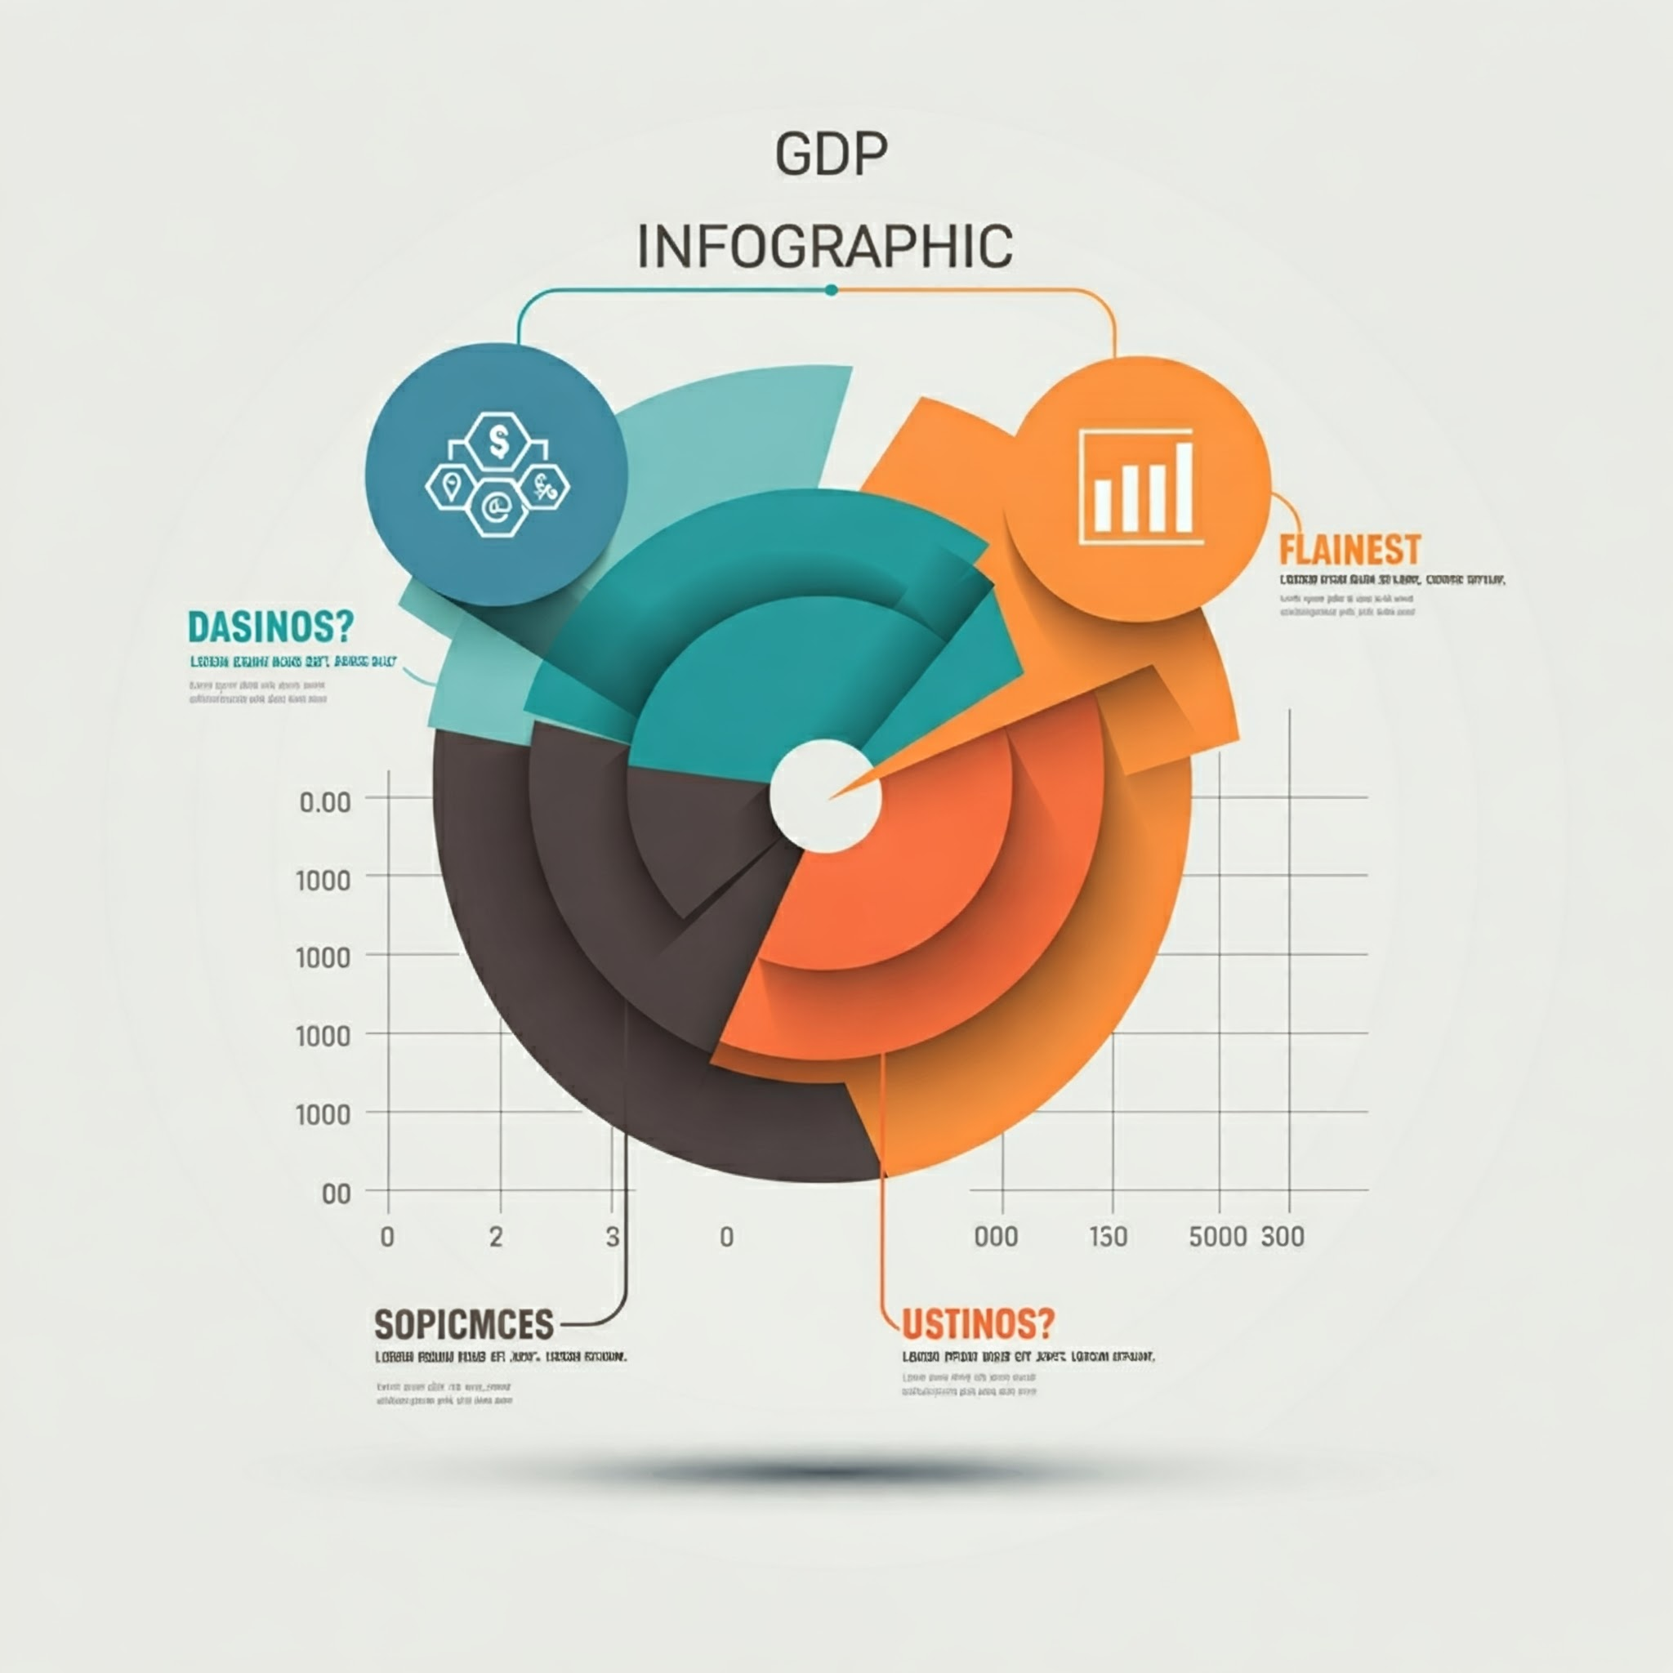
GDP and Other Metrics
Insights into countries' economic responses over the years.

Slide 9

Summary and Insights: Economic and Healthcare Trends
Analyzed economic and healthcare metrics across multiple countries.
Compared healthcare expenditure trends before and after 2020.
Evaluated GDP per capita, population growth, and other economic indicators.
Gained insights into countries' economic responses over time.
Identified the implications of GDP growth on overall economic health.

Slide 10

Conclusion: Healthcare and Economic Trends
Analysis reveals significant trends in healthcare and economic indicators over time.
Future work could examine additional factors for deeper insight.
More recent data could provide a clearer understanding of current trends.

Slide 11

Meet Our Team
Daphine, Data Scientist
2
3
4
5
6

